Slide 1


Santosh Kumar Kar,
skkar.2k2@gmail.com

Slide 2
CHAPTER – 5
Spring and Transaction
Santosh Kumar Kar
skkar.2k2@gmail.com

Slide 3
What is Transaction?
Transaction
Logical unit of work that contains one or more SQL statements
An Atomic Unit
Either all committed (applied to the database) or all rolled back (undone from the database)
In oftware, all-or-nothing operations are called transactions

Slide 4
Spring Transaction Support
Programmatic transaction
Declarative transaction

Slide 5
Persistent mechanism
Spring uses transaction support offered by the persistent mechanism such as
JDBC,
Hibernate,
JDO,
Third party JTA implementation for distributed (XA) transaction.

Slide 6
Springs transaction manager
Spring does not directly manage transactions.
It comes with a selection of transaction managers that delegate responsibility for transaction management to a platform-specific transaction implementation provided by either JTA or the persistence mechanism.
You need to choose the correct transaction manager as per your design.

Slide 7
Springs transaction manager
Transaction manager (org.springframework.*) | Use at
jdbc.datasource.DataSourceTransactionManager | Spring’s JDBC
jms.connection.JmsTransactionManager | JMS 1.1+.
jms.connection.JmsTransactionManager102 | JMS 1.0.2.
orm.hibernate.HibernateTransactionManager | Hibernate 2
orm.hibernate3.HibernateTransactionManager | Hibernate 3
orm.jpa.JpaTransactionManager | JPA
transaction.jta.WebLogicJtaTransactionManager | distributed transactions in WebLogic.
transaction.jta.WebSphereTransactionManagerFactoryBean | distributed transactions in WebSphere

Slide 8
Programmatic Transaction

Slide 9
Spring Programmatic Transaction
Developers work with the Spring transaction abstraction
Good: Developer’s has full control over the transaction
Can choose if number of transactional operations are less
Bad:
It’s burden to developers

Slide 10
2 means of
programmatic transaction management
Using the TransactionTemplate
Using a PlatformTransactionManager implementation directly

Slide 11
Steps
In Spring config
Select appropriate TransactionManager for your application to inject into TransactionTemplate.
Select appropriate TransactionTemplate and inject into DAO class.
In DAO class:
Define the property for TransactionTemplate.
Call TransactionTemplate.execute() method,
implementing the TransactionCallback interface,
implement the method doTransaction() declared in TransactionCallback interface.

Slide 12
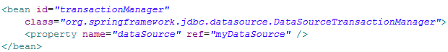
1. Config Tx Manager
Using DataSourceTransactionManager

Slide 13

2. Inject Tx Template to Dao class
org.springframework.transaction.support.TransactionTemplate

Slide 14
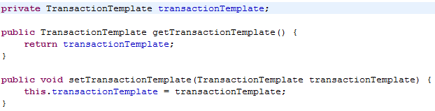
Declare tx template in DAO class

Slide 15
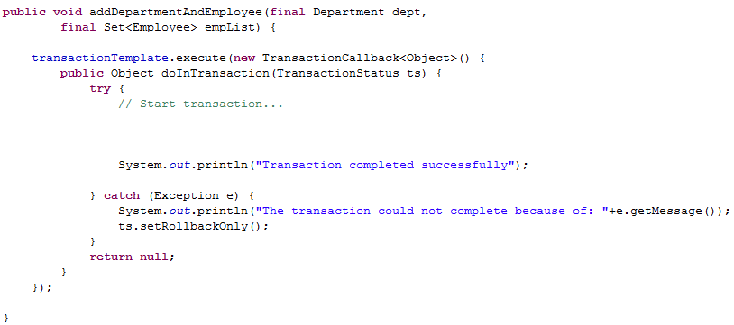
Write tx in DAO class
Your transaction

Slide 16
Declarative Transaction

Slide 17
Spring Declarative Tx
Helps to decouple an operation from its transaction rules.
Implemented through Spring’s AOP framework
Good when transactional operations are high

Slide 18
Spring Declarative Tx
3 ways to declare transactional boundaries
By proxying transaction using Spring AOP
Simple XML-declared transaction
Annotation-driven transactions.

Slide 19
TEXT

Slide 20
TEXT

